Slide 1
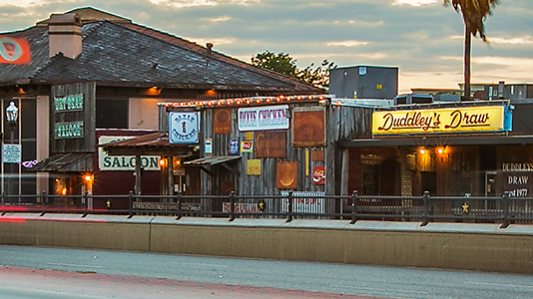
NORTHGATE

Slide 2
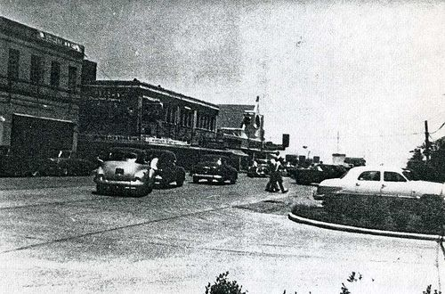
Northgate Characteristics
Unprecedented growth in residential population and licensed bars in Northgate
Un-met demands for goods and services
Unsafe conditions due to environmental factors

Slide 3
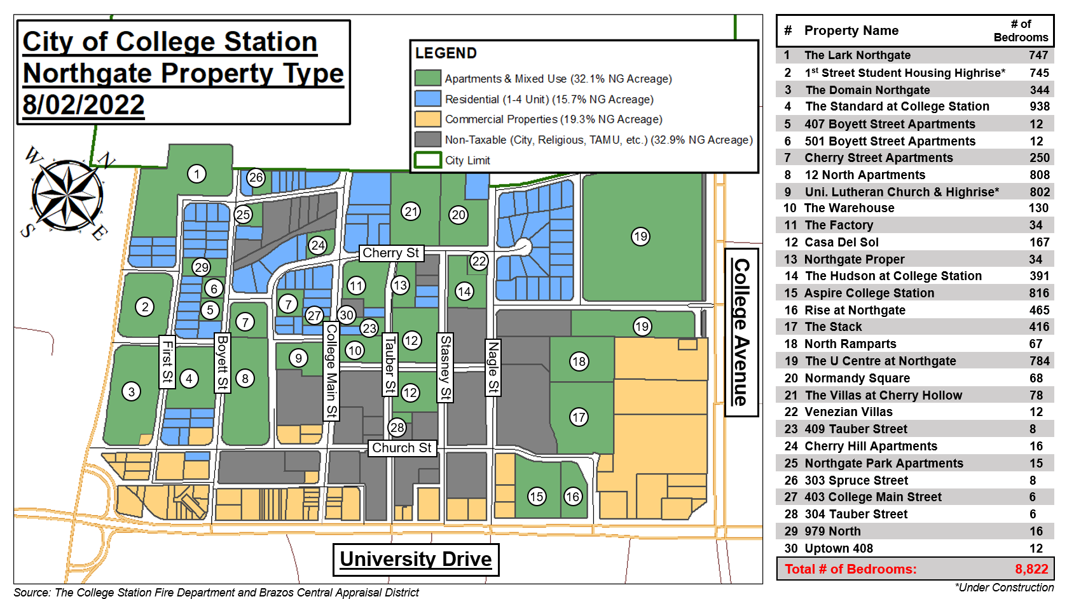

Slide 4
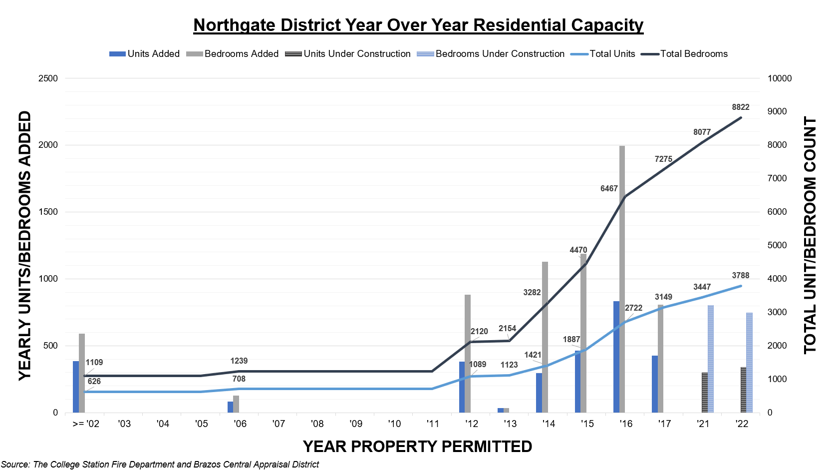

Slide 5
Northgate Apartments
2021 Police Calls for Service
Top 5 Property Tax Generators
 | Total Value | Annual Property Tax Revenue
Domain at Northgate | $20,658,966.00 | $110,446.55
Aspire College Station | $27,455,533.00 | $146,782.22
Lark Northgate | $42,416,484.00 | $226,766.16
The Sterling - Northgate | $62,231,467.00 | $332,700.62
Rise at Northgate | $35,442,771.00 | $189,483.43
Total | $188,205,221.00 | $1,006,178.98
2021 Total Calls 552

Slide 6
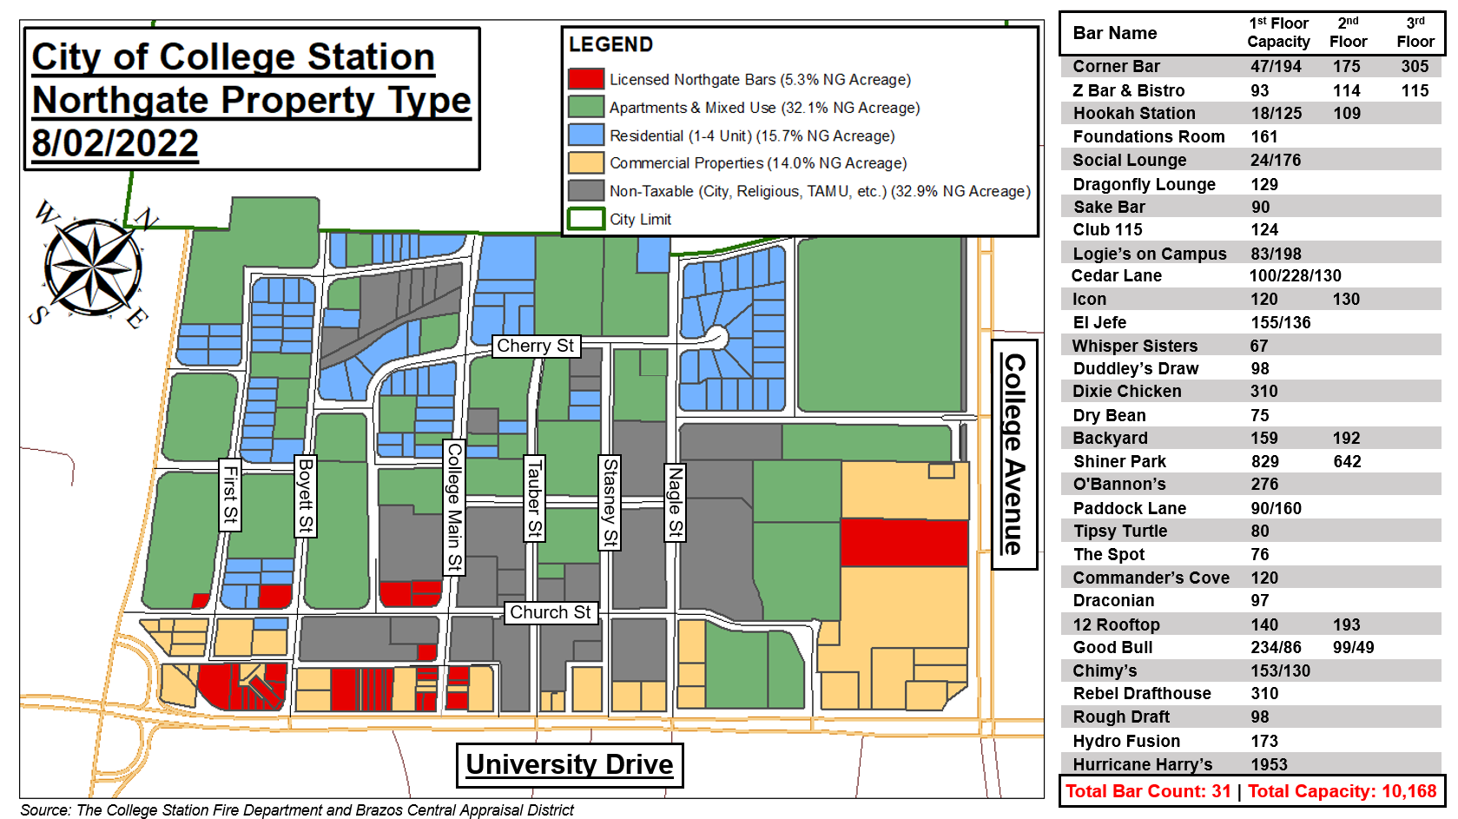

Slide 7
Police Calls for Service by Location

Slide 8
Northgate Police Calls by Time of Day

Slide 9
Arrests by Location

Slide 10
EMS Calls to Northgate
Notes:
The arrests made in Northgate are often related to alcohol, assaults, disorderly conduct, illegal substances and violence.

Slide 11
EMS Calls to Northgate by Day / Night
Notes:
The arrests made in Northgate are often related to alcohol, assaults, disorderly conduct, illegal substances and violence.

Slide 12
Fire Department Call Types in Northgate

Slide 13
City Assets required in Northgate
Police = $2,769,917 Annually
Twelve police officers, six cars, bicycle supplies and office rent
Fire = $280,000 Annually
Overtime staffing for bike team medics and Fire Marshall services
172 Transports from Northgate annually

Slide 14
Total Tax Collection for 2021
 | Northgate Bars | Mall | Century Square | University Drive East of Lincoln Ave.
Property Tax | $ 62,897 | $ 60,366 | $ 444,377 | $ 204,327
Sales Tax | $ 118,704 | $ 2,190,664 | $ 362,840 | $ 266,367
Mixed Beverage Tax* | $ 65,091 | $ - | $ - | $ -
 | $ 246,692 | $ 2,251,030 | $ 807,217 | $ 470,695
*The total mixed beverage tax collected citywide in 2021 was approximately $812,486.

Slide 15
Northgate Revenue vs Northgate Expenses
Revenue
Property Tax = $62,897 Annually
Sales Tax = $118,704 Annually
Mixed Bev. Tax = $65,091 Annually
Total Annual Tax Revenue $246,692
Expenses
Police = $1,924,917 Annually
FY 23 $565,000
Fire = $280,000 Annually
Total Annual Expenses $2,769,917

Slide 16
Environmental Short-term Considerations
Bar Safety Measures
Ordinance to require cameras within bars
Wanding required upon entry
Removal of dining boxes
Removal of outdoor speakers
Earlier hour of last call

Slide 17
Environmental Medium-term Considerations
Traffic Calming
One-way streets or complete road closures
Speed Humps on College Main and Church Ave. to slow traffic
Improve Mobility Safety
Lighted or Traditional Cross-Walks
Complete Unfinished Sidewalks on both sides
Additional Bike Lanes
Enhanced Wall along University Drive

Slide 18
Environmental Long-term Safety Considerations
Smart and effective long-term environmental planning
Limit on the number of bars in the interim until a broader solution can be created
Conditional Use Permit requirements need to be designed with legitimate conditions for all bars within the City
Create a system for maximum number of bars by district within the city
Proximity ordinances for licensed establishments
Use existing city facilities to stimulate quality and safe re-development (Surface parking lot, Promenade, Parking Garage, and ROWs)
Entertainment district fees

